Slide 1

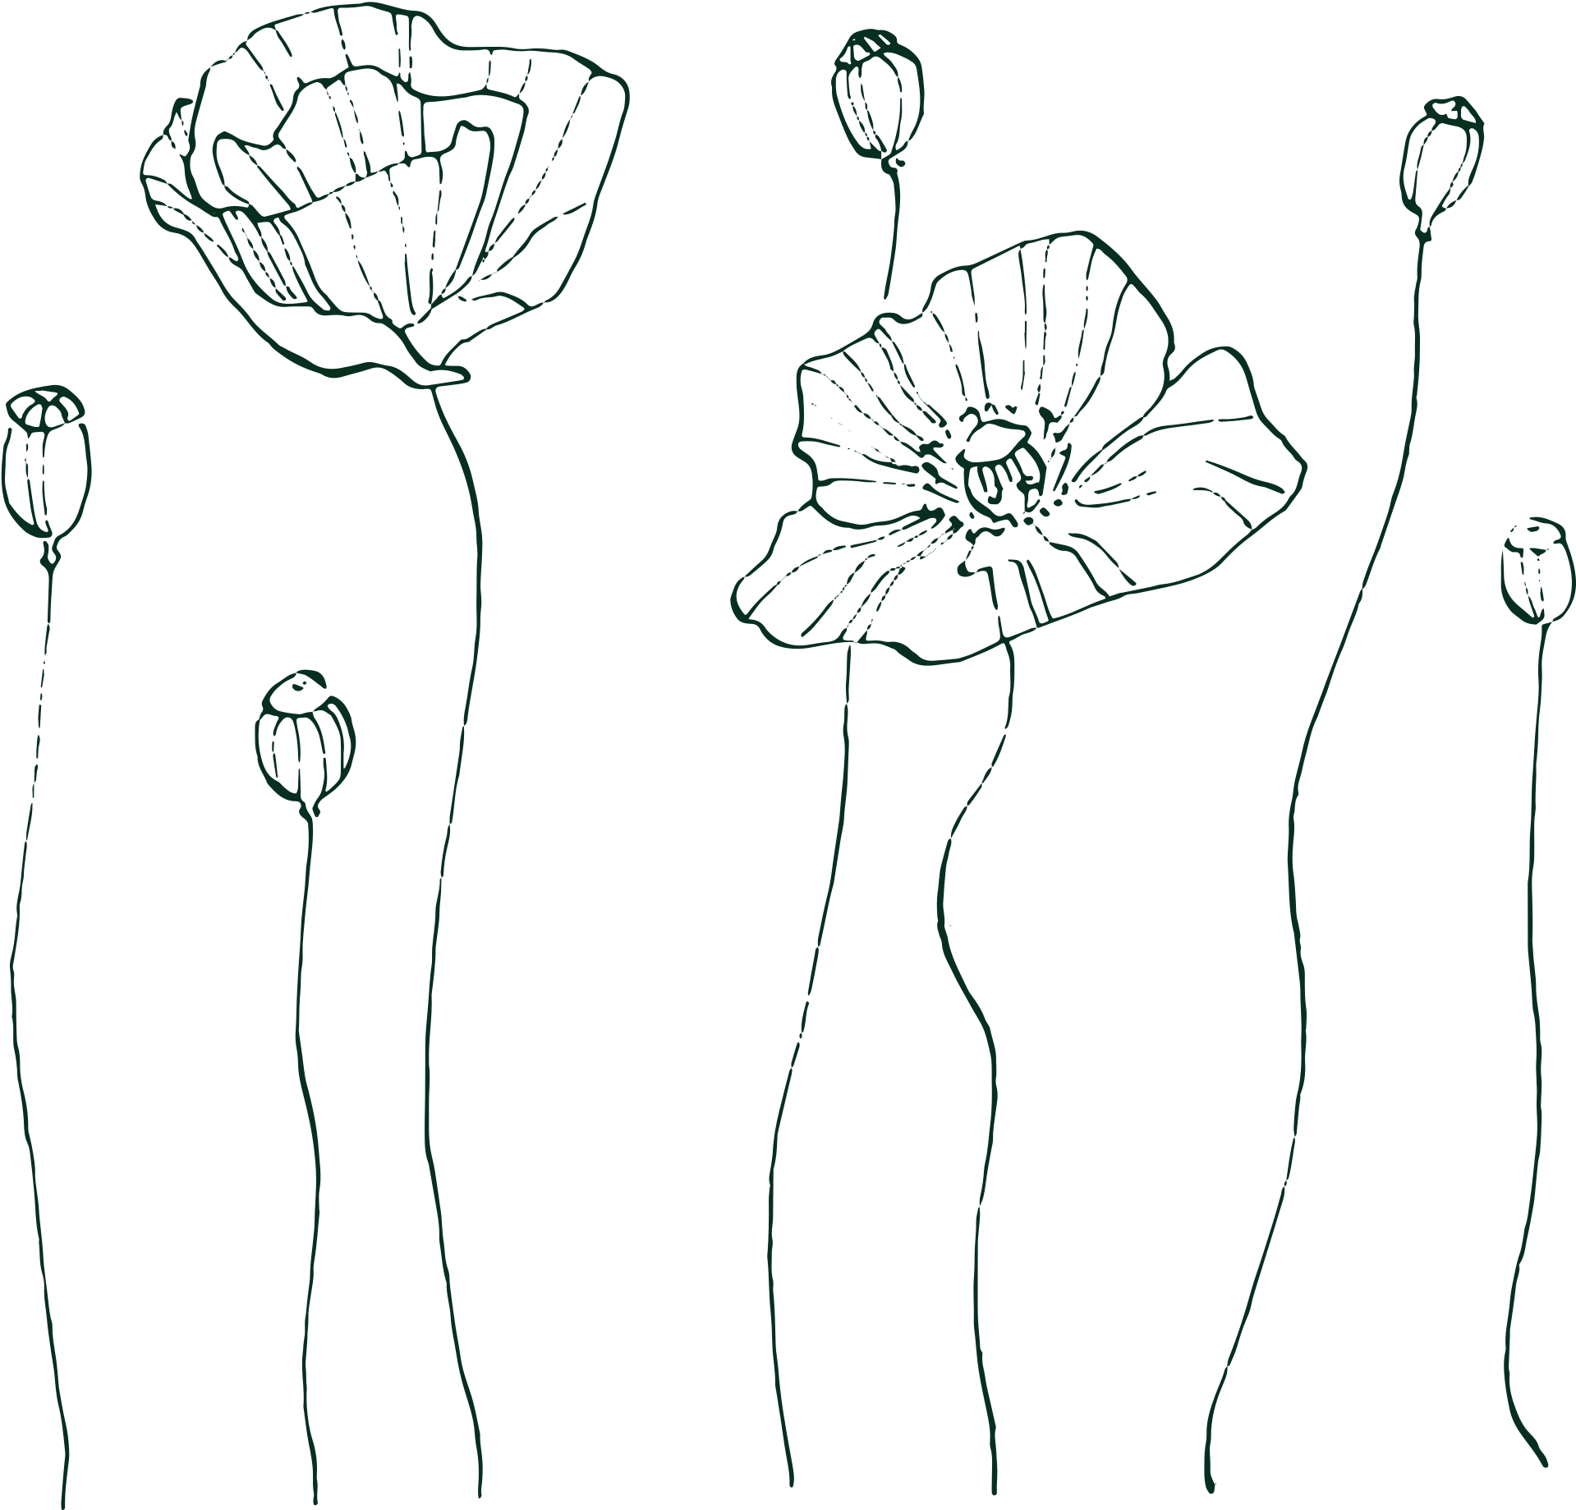







WELCOME
TO THE WEDDING OF
Amelia & William
JANUARY, 25 2026
Thank You

